Slide 1
Introduction to virtual memory and Mechanism of Address

Slide 2
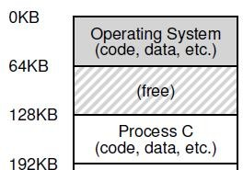
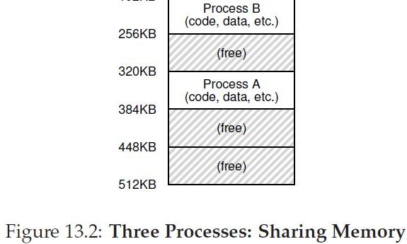
Why virtualize memory?
Because real view of memory is messy!
Earlier, memory had only code of one running process (and OS code)
Now, multiple active processes timeshare CPU
Memory of many processes must be in memory
Non-contiguous too
Need to hide this complexity from user
2

Slide 3
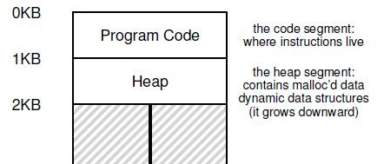
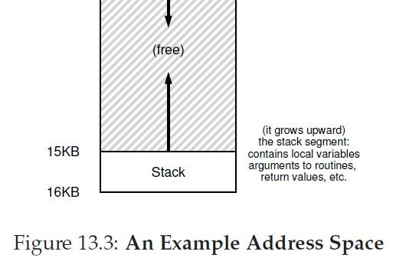
Abstraction: (Virtual) Address Space
Virtual address space: every process assumes it has access to a large space of memory from address 0 to a MAX
Contains program code (and static data), heap (dynamic allocations), and stack (used during function calls)
Stack and heap grow during runtime
CPU issues loads and stores to virtual addresses

Slide 4
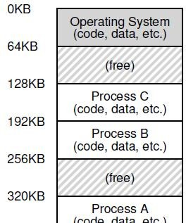
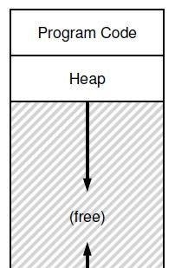
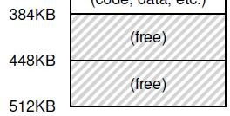
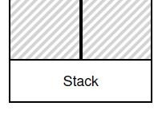
How is actual memory reached?
Address translation from virtual addresses (VA) to physical addresses (PA)
CPU issues loads/stores to VA but memory hardware accesses PA
OS allocates memory and tracks location of processes
Translation done by memory hardware called Memory Management Unit (MMU)
OS makes the necessary information available

Slide 5
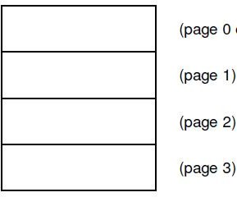
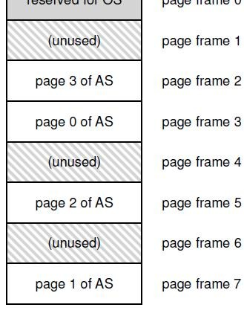
Example: Paging
OS divides virtual address space into fixed size pages, physical memory into frames
To allocate memory, a page is mapped to a free physical frame
Page table stores mappings from virtual page number to physical frame number for a process (e.g, page 0 to frame 3)
MMU has access to page tables, and uses it to translate VA to PA

Slide 6
Goals of memory virtualization
Transparency: user programs should not be aware of the messy details
Efficiency: minimize overhead and wastage in terms of memory space and access time
Isolation and protection: a user process should not be able to access anything outside its address space

Slide 7
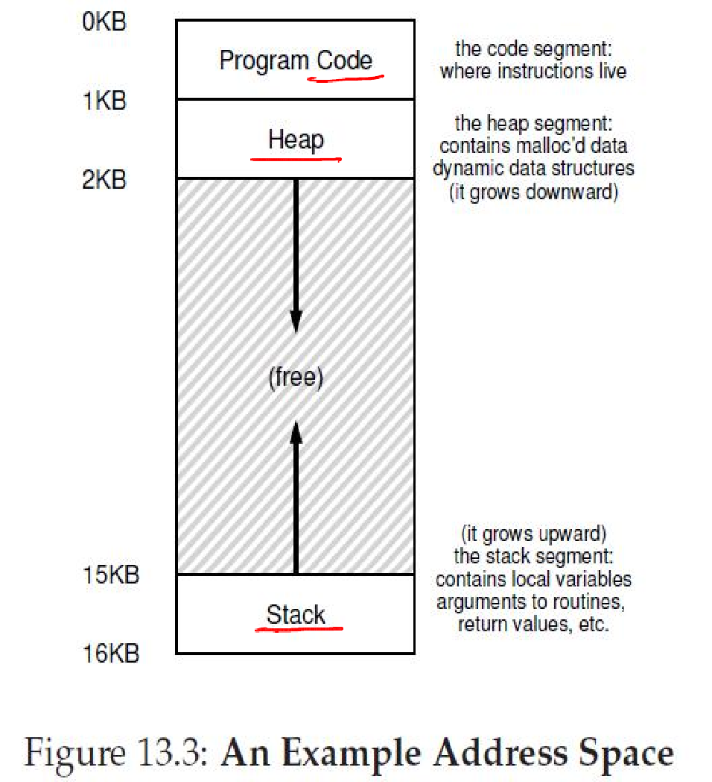
How can a user allocate memory?
OS allocates a set of pages to the memory image of the process
Within this image
Static/global variables are allocated in the executable
Local variables of a function on stack
Dynamic allocation with
malloc on the heap

Slide 8
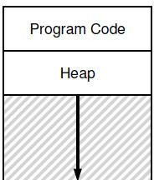
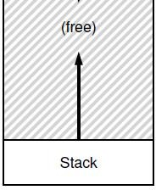
Memory allocation system calls
malloc implemented by C library
– Algorithms for efficient memory
allocation and free space management
To grow heap, libc uses the
brk/sbrk system call
A program can also allocate a page sized memory using the mmap()system call
– Gets “anonymous” page from OS
brk
mmap

Slide 9
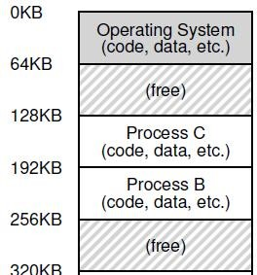
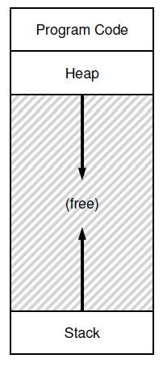
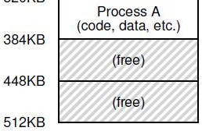
A subtle point: what is the address space of the OS?
OS is not a separate process with its own address space
Instead, OS code is part of the address space of every process
A process sees OS as part of its code (e.g., library)
Page tables map the OS addresses to OS code
OS

Slide 10
How does the OS allocate memory?
OS needs memory for its data structures
For large allocations, OS allocates a page
For smaller allocations, OS uses various memory allocation algorithms (more later)
– Cannot use libc and malloc in kernel!

Slide 11
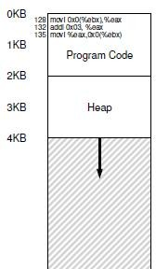


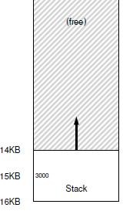

A simple example
Consider a simple C function
It is compiled as follows
Virtual address space is setup by OS during process creation

Slide 12
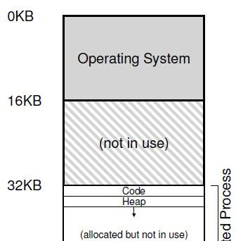
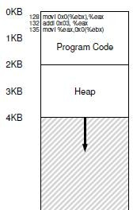
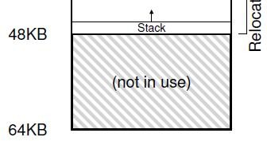
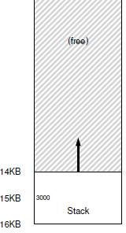

Address Translation
Simplified OS: places entire memory image in one chunk
Need the following translation from VA to PA
– 128 to 32896 (32KB + 128)
1KB to 33 KB
20KB? Error!

Slide 13
Who performs address translation?
In this simple example, OS tells the hardware the base (starting address) and bound (total size of process) values
Memory hardware Memory Management Unit (MMU) calculates PA from VA
MMU also checks if address is beyond bound
OS is not involved in every translation

Slide 14
Role of hardware in translation
CPU provides privileged mode of execution
Instruction set has privileged instructions to set translation information (e.g., base, bound)
Hardware (MMU) uses this information to perform translation on every memory access
MMU generates faults and traps to OS when access is illegal (e.g., VA is out of bound)

Slide 15
Role of OS in translation
OS maintains free list of memory
Allocates space to process during creation (and when asked) and cleans up when done
Maintains information of where space is allocated to each process (in PCB)
Sets address translation information (e.g., base & bound) in hardware
Updates this information upon context switch
Handles traps due to illegal memory access

Slide 16
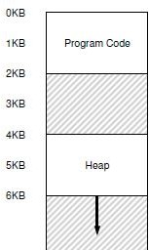
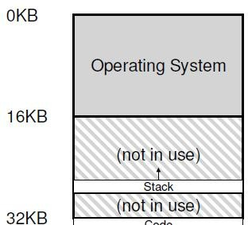
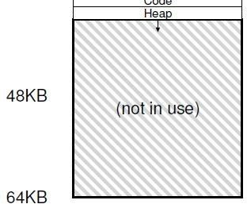
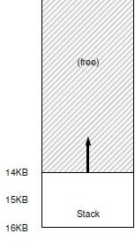
Segmentation
Generalized base and bounds
Each segment of memory image placed separately
Multiple (base, bound) values stored in MMU
Good for sparse address spaces
But variable sized allocation leads to external fragmentation
– Small holes in memory left between segments

Slide 17
Thank you!!!!

